Slide 1



NEEDS IMAGE OF SOME SORT
Notes:
Main Page

Slide 2



LOGIN
Notes:
Login Page

Slide 3

Notes:
Account Creation Page

Slide 4







Notes:
Account Creation Page with Profile Image Selection

Slide 5


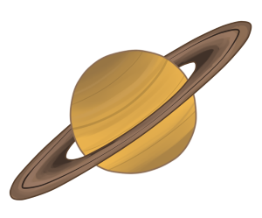

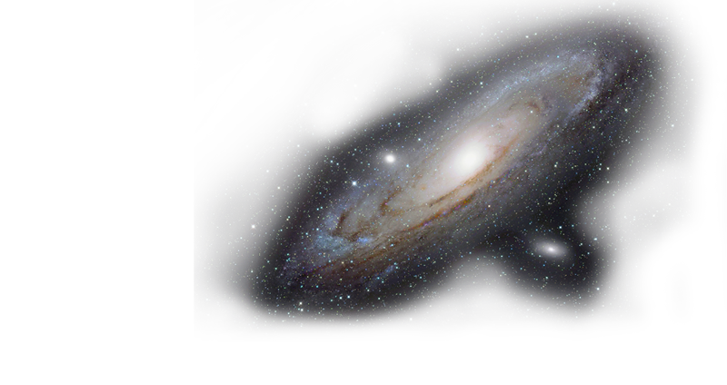
Ashley
GALACTIC GEOMETRY
ANDROMEDA ARITHMETIC
COSMIC COUNTING
Notes:
Possibly make the “home” planet a button to return to the landing screen?
Our landing page shows the player the entire universe in which their journey takes place. It consists of 3 different places to visit, each focused a different math standard, and each will have 3 different difficulty levels, Easy, Medium, and Hard. Easy mode is for K-1st grade, Medium is for 2nd-3rd grade, and Hard is for 4th grade. The user always begins their journey on the small planet to the far left of the screen as referenced by the spaceship, and as the player progresses along their journey the spaceship moves with them to each destination. The overall color scheme for the entire application is based off this landing screen. The text for the title of each location uses a color palette that was derived from the picture of each location. For example, the greyish color of “Galactic Geometry” was taken directly from the image of the galaxy pictured via “eyedropper” method. The bright red title and exit button contrast very well against the dark blues/black of the background, and the light blues and gold colors of the other titles stand out very well. The interface is aligned consistently throughout the application, giving the player a sense of familiarity from one location to the next.
Andromeda color: 60C6B9 Galactic color: CBC4C7
Cosmic color: E0AB4C

Slide 6


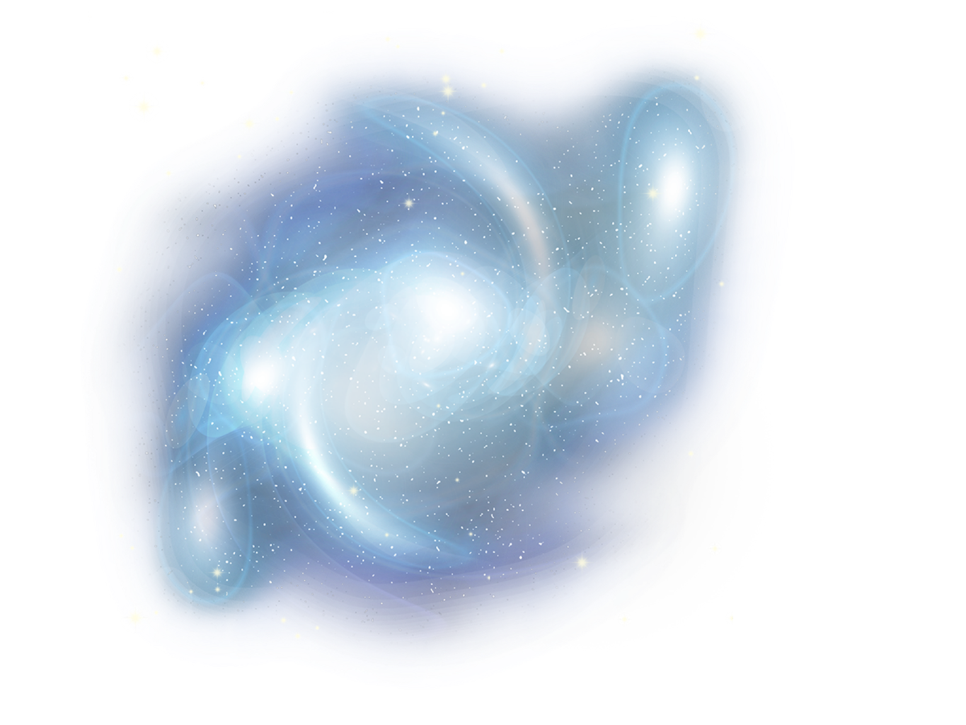



GALACTIC GEOMETRY
CAN YOU HELP PUT THESE COMETS BACK TOGETHER AGAIN ASHLEY?
ASHLEY
Notes:
The Galactic Geometry location will provide the player with different shapes that are broken into multiple pieces. They are tasked with reassembling each object by dragging and dropping the correct pieces into the correct positions. There will be varying difficulty in terms of the shapes used, the number of pieces an object is broken into, etc. The color scheme here was again developed via the eyedropper method, with the light blue hues matching the blue galaxy pictured here.

Slide 7
Ashley
GALACTIC GEOMETRY
ANDROMEDA ARITHMETIC
COSMIC COUNTING
Notes:
Andromeda color: 60C6B9 Galactic color: CBC4C7
Cosmic color: E0AB4C

Slide 8


GALACTIC GEOMETRY
CAN YOU HELP PUT THE SHIP BACK TOGETHER ASHLEY?
ASHLEY

Slide 9


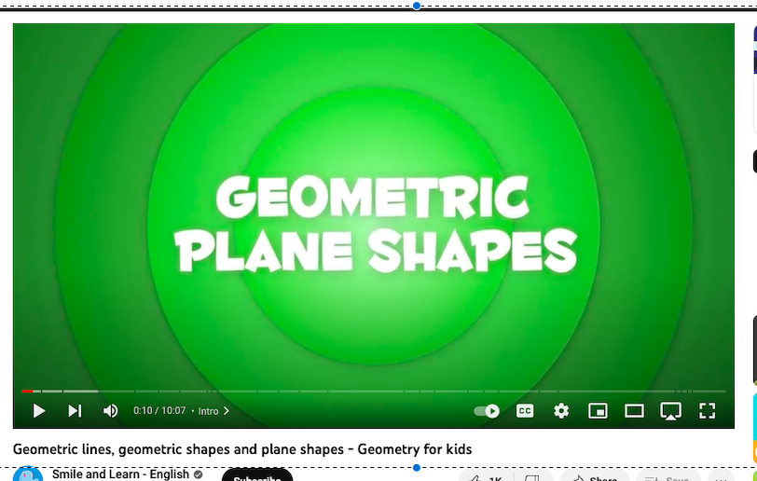

ASHLEY
Which shape is not a quadrilateral?
A.Square
B.Circle
C.Rectangle
D.Diamond

Slide 10






Zak
Results screen
Reward for correct answers? Green check marks for correct
Red X for incorrect answers

Slide 11


Zak
YOU WIN!
#
Reward animation/screen for completion of the ‘journey’

